Slide 1
What are….
“Current Affairs”?

Slide 2
What are….
The biggest issues in 2017?

Slide 3
What about viewing current affairs…
Through one specific topic?

Slide 4
And what….
If that topic was drugs?

Slide 5
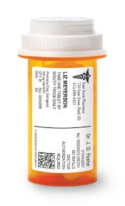
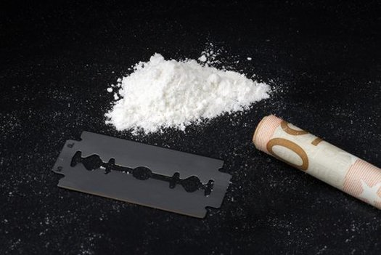
Drugs vs. DRUGS

Slide 6
Why is one legal….
And the other illegal?
How are these categories created?
And what do they tell us about how we think about things like drugs?

Slide 7
And do these categories tell us about anything else?

Slide 8
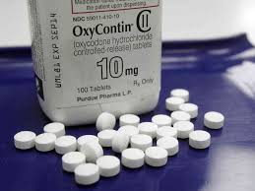
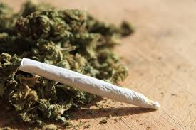
A tale of two drugs

Slide 9
One of these drugs….
Is highly addictive.
Has played a role in thousands of overdose deaths (14,800 overdose deaths in 2008).
Has these ingredients (among others): butylated hydroxytoluene (BHT), hypromellose, polyethylene glycol 400, polyethylene oxide, magnesium stearate, titanium dioxide.
Has these side effects: constipation, nausea, vomiting, and other symptoms including somnolence (sleepiness), dizziness, itching, headache, dry mouth, sweating, and decreases in the ability to feel pain. More serious side effects include respiratory depression, apnea (stopped breathing), respiratory arrest, circulatory depression, hypotension (low blood pressure), shock, and death.

Slide 10
The other….
No definitive proof that it is addictive.
Occurs in nature (it’s an herb).
Medical journal: “it is nearly impossible to die from an overdose” from this drug.

Slide 11
Both of these drugs….
Are taken to deal with chronic pain.
One is legal.
One is illegal.
Why is this the case?
What else do these definitions – other than medical factors – rely upon?

Slide 12
Politics – and Money
In the United States, the pharmaceutical industry has an incredibly powerful lobbying presence in Washington, DC.
Large corporations (job-makers) making large amounts of money – and giving it to politicians. These politicians then have a hand in laws that regulate such drugs.
By late 2013, more than 70% of Purdue Pharma’s $1.8 billion in annual revenue came from the sale of OxyContin.
Do drug dealers have the same status?
Who do we usually associate with the supply and sale of marijuana?

Slide 13
Policing, Prisons, and Race
The U.S. prison population is more than 2.4 million – and it has more than quadrupled since 1980.
That means more than one out of every 100 American adults is behind bars.
The single largest driver in the increase in the federal prison population since 1998 is longer sentences for drug offenders.
Over 50 percent of inmates currently in federal prison are there for drug offenses.
By 2009, Latino convicts represented the largest ethnic population in the federal prison system, accounting for 40 percent of those convicted of federal crimes.
African-Americans? 37 percent.
What do such numbers tell us?
What would happen if marijuana was legalized?

Slide 14
International Affairs
Issues of immigration
Border control
Global trade
Criminal syndicates
Terrorism
And finally….

Slide 15
Technological advancement
How so?

Slide 16
History
All of these current moments have histories behind them.
These histories impact current affairs more than most commentators care to admit.
Our task? To unpack these histories over the next four weeks….

Slide 17
And one more example….
To show that this impacts more people than you may think…

Slide 18
In a highly cited study….
The journal Neuroscience & Biobehavioral Reviews found that a certain substance meets the criteria for a substance of abuse and may be addictive to those who binge on it. It does this by affecting the chemistry of the limbic system, the part of the brain that’s associated with emotional control.
The study found that “intermittent access” to this substance “can lead to behavioral and neurochemical changes that resemble the effects of a substance of abuse.”

Slide 19
In fact….
Paul van der Velpen, head of Amsterdam's health services, has warned that this substance is “just like alcohol and tobacco.”
He went on to note that this substance is “the most dangerous drug of this time and can still be easily acquired everywhere.”

Slide 20
And this drug….
Causes a host of health-related problems.
Is responsible for 180,000 deaths worldwide each year.

Slide 21
What drug….
Am I talking about?

Slide 22
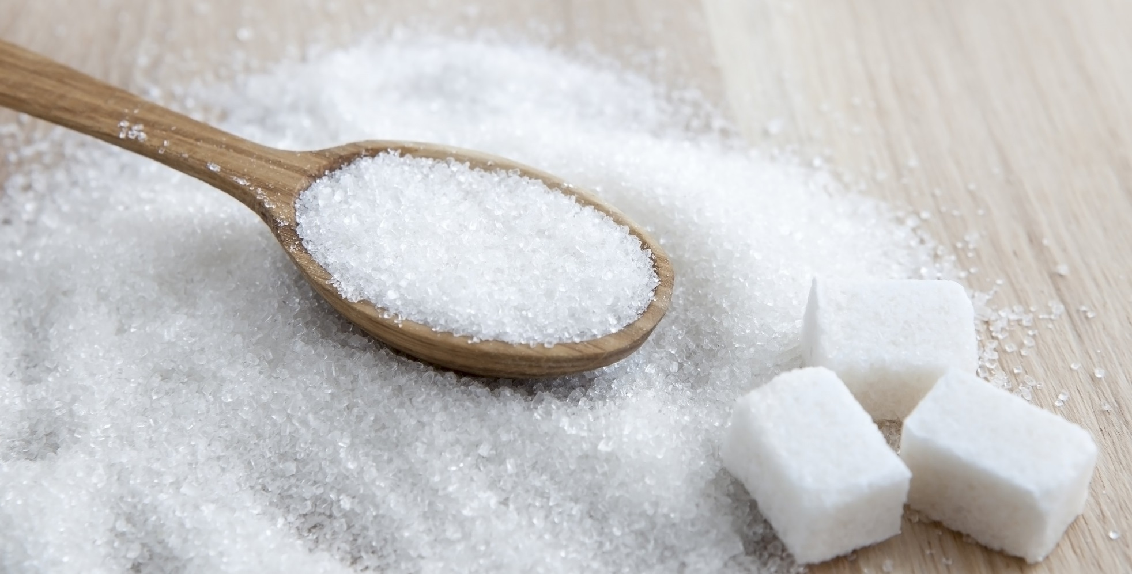
Sugar

Slide 23
Why is this “drug”…..
Legal?
Not better regulated?

Slide 24
This is what….
We’ll spend the next ten weeks trying to unpack.

